Slide 1
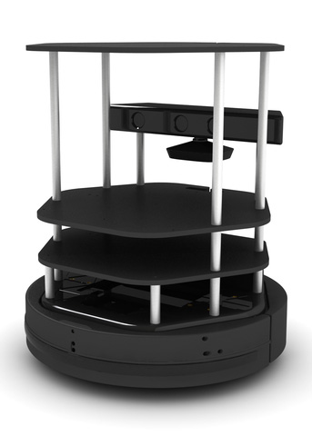
CMP3103
Autonomous Mobile Robotics
Onis Brown (14546258)

Slide 2
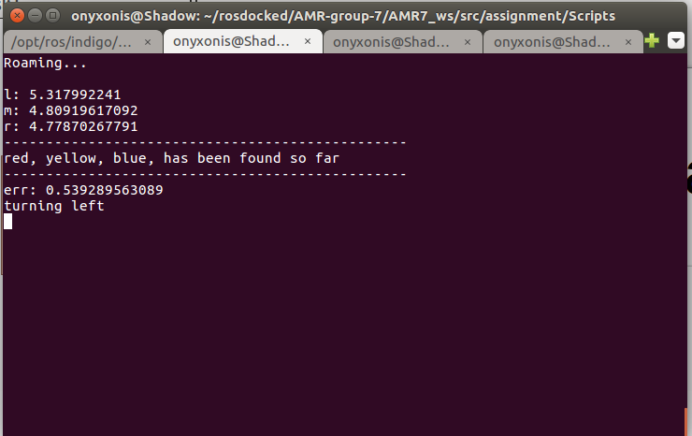
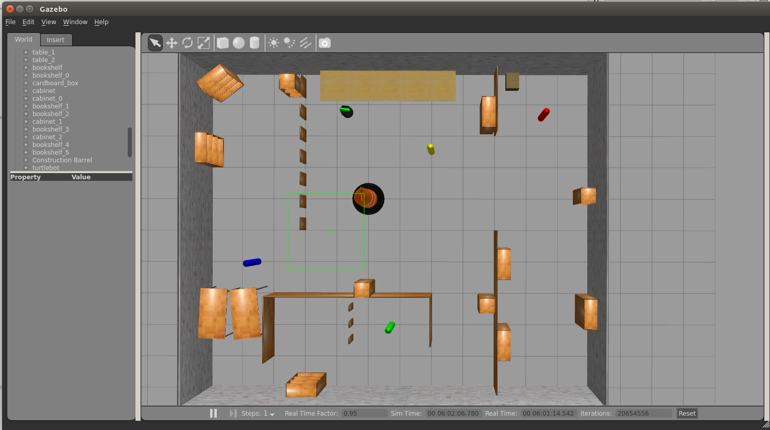
Navigation
When roaming Uses kinematics to always move towards open spaces when a post isn’t in view
If it comes across a corner it will reverse out of the corner in the opposite direction to which it entered.
When a pillar is encountered robot attempts to travel back to the location it started tracking the pillar from before roaming. If this fails robot simply reverses

Slide 3
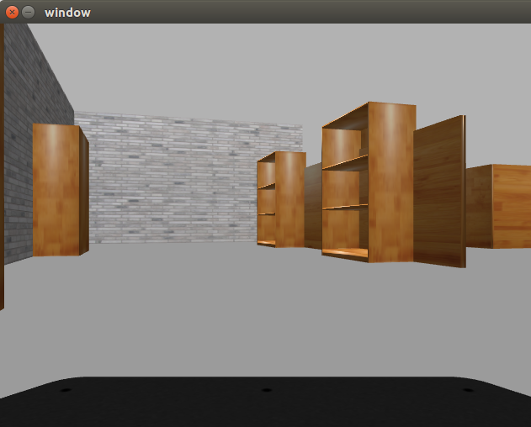
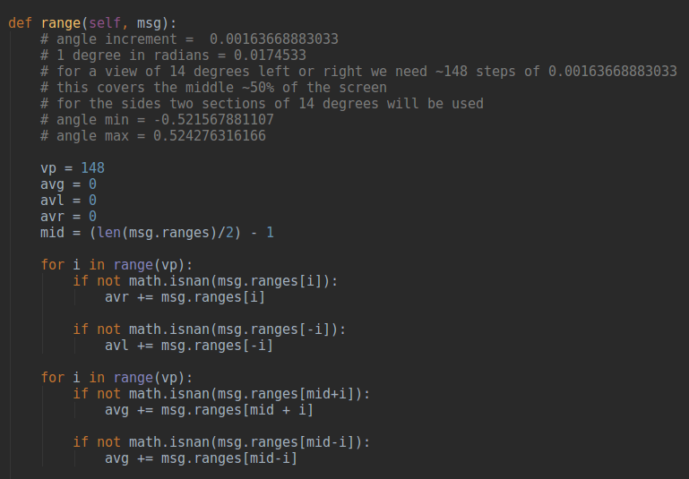
Vision
Triggers pillar tracking when pillar colour is in view. Pillars that have been located are remembered and ignored from that point on
Uses the scan topic to find 3 distances which are the middle 28 degrees region of the screen, and the left and right 14 degree regions of the screen.
Uses these ranges to navigate around objects and corners kinematically.

